Slide 1


MIND MAPS

Slide 2
Mind Maps are probably the
most common form of Idea
generating strategies
So what are they?
Basically a mind map is literally a map of your mind.
How?
Put the topic (or title of your project) in the centre of a large page. Think of relations to the topic and let your mind run free.

Slide 3
Tips
Be messy! A mind map helps you avoid thinking linearly (helps you avoid thinking in a structured manner). Drawing your mind map in an unorganised fashion symbolises the way your mind thinks.
Don’t be selective during the session. Splash out any ideas or thoughts you may have, you never know what might spark off an idea!
Don’t pause, don’t judge, don’t edit!

Slide 4
Lets take a snow mobile project as a basic example:
For clarity purposes this mind map is typed, yours should be handwritten to allow for speed and continuous flow of ideas .

Slide 5
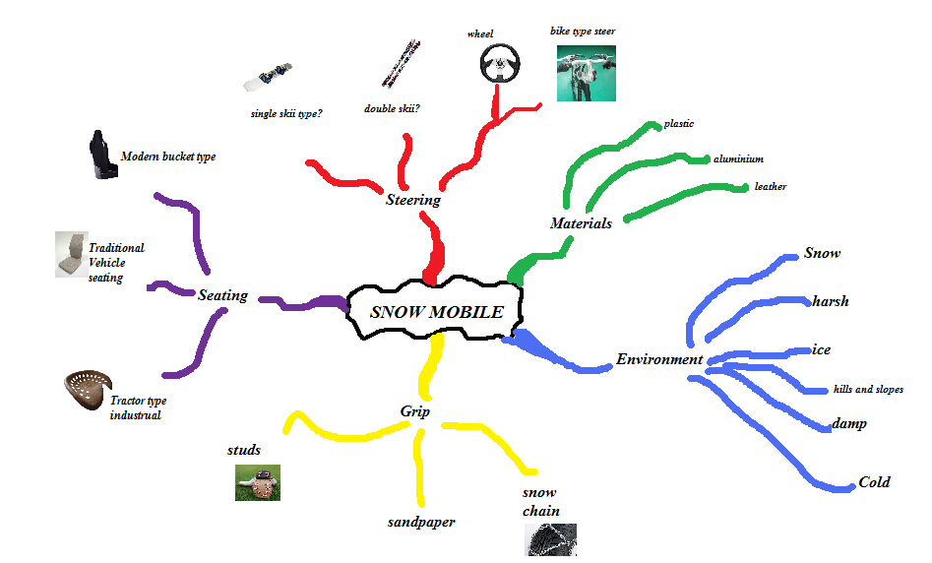

Slide 6

Exhaust!
Exhaust each branch. Keep writing/sketching down whatever comes into your head. Keep going until you cant think of any more.

Slide 7
Activity time:
Create a detailed mind map for each of the key words:
New mobile phone
A new flying vehicle concept
An automatic pet feeder
A circularity machine for the elderly

Slide 8
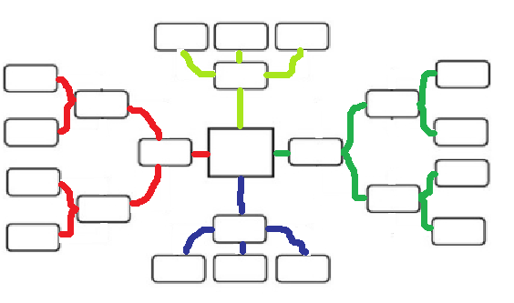
Use and extend the following
Mind map template if you please:

